Slide 1
Table of Content
Domain
Introduction
Abstract
Literature Survey
Analysis & Explanation of Problem Identified
Existing System
Proposed System
Architecture Diagram
Modules
Output
Conclusion
References

Slide 2
Domain
Financial Technology (FinTech) & Fraud Detection: Real-time automated fraud detection for electronic payment networks processing billions of daily transactions.
Blockchain & Cryptographic Ledger Technology: Permissioned SHA-256 Merkle tree blockchain ensuring tamper-proof transaction audit trails with cryptographic non-repudiation.
Explainable AI (XAI): SHAP waterfall attributions providing transparent, mathematically rigorous justifications for every fraud decision.

Slide 3
Introduction
Financial fraud presents a persistent threat to global digital commerce, with payment card fraud accounting for tens of billions of dollars in annual losses worldwide.
Traditional rule-based fraud screening systems rely on static threshold conditions and fail to adapt to modern adversarial fraud patterns including CNP fraud, account takeover, and micro-transaction probing.
ML classifiers operate as black boxes—when legitimate transactions are blocked, no interpretable justification is provided, causing customer friction and compliance costs.
This thesis presents a hybrid framework combining explainable ML anomaly detection with an immutable SHA-256 Merkle tree blockchain ledger, built using React 18, FastAPI, and a triple-database SQLite topology.

Slide 4
ABSTRACT
Dual-Engine ML Classification: Random Forest supervision (P_RF) combined with Isolation Forest anomaly scoring (S_IF) produces a hybrid composite risk score R_final = 0.70*P_RF + 0.30*S_IF.
SHAP Feature Attribution: TreeExplainer computes exact Shapley values identifying specific feature contributions driving fraud risk scores for every flagged transaction.
SHA-256 Merkle Blockchain: Permissioned cryptographic ledger with recursive hash verification ensuring any unauthorized transaction modification invalidates the entire chain.
Smart Contract Dispute Recovery: Automated finite state machine controlling card governance through ACTIVE, SUSPENDED_RISK, FROZEN_FRAUD, and RESTORED_VERIFIED states.

Slide 5
Contd…
Triple Database Isolation:
bank_core.db: Customer accounts, card balances, encrypted credentials
soc_security.db: Threat logs, defender playbook traces, telemetry
blockchain_ledger.db: Immutable block headers, Merkle tree nodes, signed hashes
Automated Security Auto-Repair: Instant card freezing, token revocation, and dispute recovery when R_final exceeds critical threshold (0.85).

Slide 6
LITERATURE SURVEY
S.No | Title | Author | Description | Year | Advantages | Disadvantages
1 | Bitcoin: P2P Electronic Cash | Nakamoto, S. | Decentralized SHA-256 consensus without central authority | 2008 | Foundation of blockchain | Low throughput
2 | Ethereum: Secure Transaction Ledger | Wood, G. | Turing-complete smart contracts on blockchain | 2014 | Programmable contracts | Gas fees/latency
3 | Random Forests | Breiman, L. | Ensemble decision tree classification | 2001 | Robust against overfitting | Feature engineering

Slide 7
CONTD...
S.No | Title | Author | Description | Year | Advantages | Disadvantages
4 | Isolation Forest | Liu et al. | Unsupervised anomaly detection via isolation | 2008 | Detects novel fraud | Threshold sensitivity
5 | SHAP: Feature Attribution | Lundberg & Lee | Unified explanation via cooperative game theory | 2017 | Mathematical guarantees | Computation cost
6 | Credit Card Fraud Calibration | Dal Pozzolo et al. | SMOTE + undersampling for class imbalance | 2015 | Improved precision-recall | Synthetic data risks

Slide 8
CONTD...
S.No | Title | Author | Description | Year | Advantages | Disadvantages
7 | Merkle Digital Signatures | Merkle, R. C. | Cryptographic hash tree verification | 1987 | Efficient verification | Storage overhead
8 | Data Mining for Fraud | Bhattacharyya et al. | Statistical learning outperforms rule-based systems | 2011 | Empirical validation | Manual feature engineering
9 | Zcash Protocol | Zcash Team | Zero-knowledge proofs for private transactions | 2019 | Privacy preservation | Complexity

Slide 9
CONTD...
S.No | Title | Author | Description | Year | Advantages | Disadvantages
10 | Hyperledger Fabric | Androulaki et al. | Permissioned enterprise blockchain | 2018 | High throughput | Enterprise-focused
11 | Supervised Learning Comparison | Caruana et al. | Hybrid supervised+unsupervised superiority | 2006 | Empirical comparison | Limited scope
12 | Zerocash: Anonymous Payments | Ben-Sasson et al. | zk-SNARKs for private blockchain | 2014 | Strong privacy | Computational cost

Slide 10
CONTD...
S.No | Title | Author | Description | Year | Advantages | Disadvantages
13 | XGBoost | Chen & Guestrin | Gradient boosted trees for classification | 2016 | State-of-art AUC | Hyperparameter tuning
14 | SMOTE | Chawla et al. | Synthetic oversampling for minority classes | 2002 | Balances dataset | May introduce noise
15 | Smart Contracts | Szabo, N. | Formalized computerized protocol execution | 1997 | Automated agreement | Theoretical only

Slide 11
ANALYSIS & EXPLANATION OF PROBLEM IDENTIFIED
Centralized banking architectures rely on opaque ML black boxes paired with mutable database ledgers—compliance officers cannot understand why transactions are blocked.
Centralized database logs are vulnerable to internal tampering, unauthorized audit manipulation, and single-point-of-failure attacks.
Legacy rule-based fraud screening uses static thresholds that fail against modern adversarial patterns: Card-Not-Present fraud, Account Takeover, and automated micro-transaction probing.
Existing systems lack automated dispute recovery—cardholders must undergo manual phone verification for false-positive blocks.

Slide 12
Existing System
Commercial fraud detection software focuses on classification while treating database logging as a separate concern, requiring manual SOC correlation during incidents.
Traditional SQL databases lack cryptographic non-repudiation—audit trails rely on trust in database administrators rather than mathematical proof.
ML classifiers operate as black boxes, returning arbitrary risk scores without feature-level explanations, violating GDPR's Right to Explanation.
No Automated Dispute Recovery: Manual phone verification processes cause significant cardholder friction and delayed resolution.
Centralized Database Vulnerability: Single-point-of-failure risks from monolithic database architectures without privilege separation.

Slide 13
Proposed System
Dual-engine ML combining Random Forest (70% weight) and Isolation Forest (30% weight) for hybrid supervised-unsupervised fraud detection.
SHAP TreeExplainer generates exact Shapley values for every flagged transaction, surfacing top contributing features like location velocity and transaction amount.
Permissioned SHA-256 Merkle tree blockchain with Raft consensus achieving sub-20ms latency and zero transaction fees.
Triple-database isolation separating core banking, SOC telemetry, and blockchain ledger data to eliminate single-point-of-failure risks.
Smart contract FSM for automated dispute recovery with 15-minute MFA challenge windows.

Slide 14
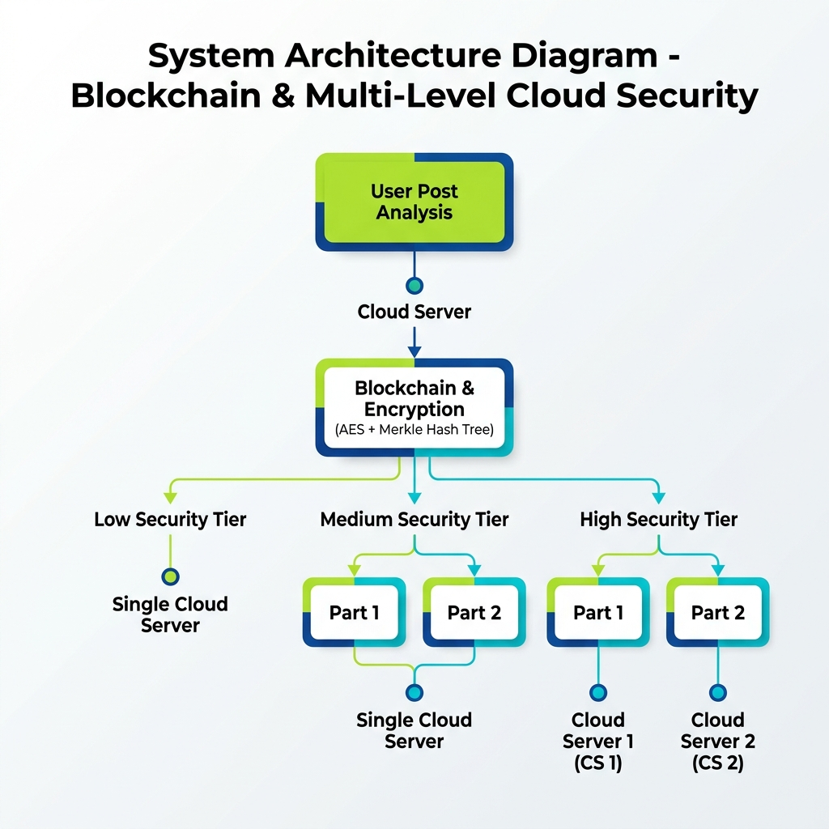
Architecture Diagram

Slide 15
Modules
Customer Payment Portal
Manager Security Operations Center (SOC)
Explainable AI (XAI) Diagnostic Modal
Blockchain Ledger Explorer
ML Fraud Classification Engine
Smart Contract Dispute Recovery

Slide 16
Module : 1 : Customer Payment Portal
The Customer Payment Portal provides an interactive checkout interface where cardholders execute transactions, view real-time authorization statuses, and inspect personal transaction histories. Each transaction displays its composite risk score, authorization decision (APPROVED/BLOCKED/FLAGGED), and timestamp. For blocked transactions, the portal surfaces a dispute recovery workflow allowing cardholders to verify identity via MFA tokens.

Slide 17
Module : 2 : Manager SOC Dashboard
The Manager Security Operations Center Dashboard serves as a central command view displaying real-time transaction streams, flagged fraud alerts, system throughput metrics, and threat telemetry. SOC analysts can drill into individual transactions to examine SHAP waterfall charts, verify blockchain ledger integrity, and trigger automated security auto-repair workflows for compromised cards.

Slide 18
Module : 3 : XAI Diagnostic Modal
The Explainable AI Diagnostic Modal surfaces SHAP waterfall charts breaking down exact feature contribution scores for any flagged transaction. Features like 'Transaction Amount > $4,500' contributing +0.38 to risk and 'Location Distance > 2,000 miles' contributing +0.27 are displayed in a ranked bar chart, providing compliance officers with transparent, mathematically rigorous fraud justifications.

Slide 19
Module : 4 : Blockchain Ledger Explorer
A cryptographic inspection tool allowing compliance officers to browse committed blocks, verify SHA-256 Merkle roots, and trace transaction immutability across the permissioned ledger.
Each block contains: Block Index, Timestamp, Previous Block Hash, Merkle Root Hash, and Consensus Nonce.
Automated attack detection: any unauthorized modification to a transaction record triggers Merkle root mismatch within 0.4ms.

Slide 20
Module : 5 : ML Fraud Classification Engine
Supervised Model:
Random Forest ensemble of 100 decision trees evaluates transaction features against historical fraud patterns, outputting supervised probability P_RF.
Unsupervised Model:
Isolation Forest calculates anomaly score S_IF based on tree isolation depth, detecting unusual spending behaviors deviating from baseline patterns.

Slide 21
Module : 5
Composite Risk Scoring:
R_final = 0.70 * P_RF + 0.30 * S_IF balances supervised pattern matching with novel anomaly detection.
Haversine Formula:
Spatial velocity computation detects physically impossible travel speeds between consecutive transactions, automatically flagging v > 500 mph.
Feature Pre-processing:
Z-score standardization for numerical attributes, temporal time-delta features, andHaversine distance calculations for spatial anomaly detection.

Slide 22
Module : 6 : Smart Contract Dispute Recovery
The dispute recovery smart contract enforces a finite state machine controlling card governance through four phases: ACTIVE, SUSPENDED_RISK, FROZEN_FRAUD, and RESTORED_VERIFIED. When anomaly triggers SUSPENDED_RISK, the contract grants a 15-minute MFA challenge window. Successful cryptographic signature verification transitions the state to RESTORED_VERIFIED, unfreezing the card without manual bank employee intervention.

Slide 23
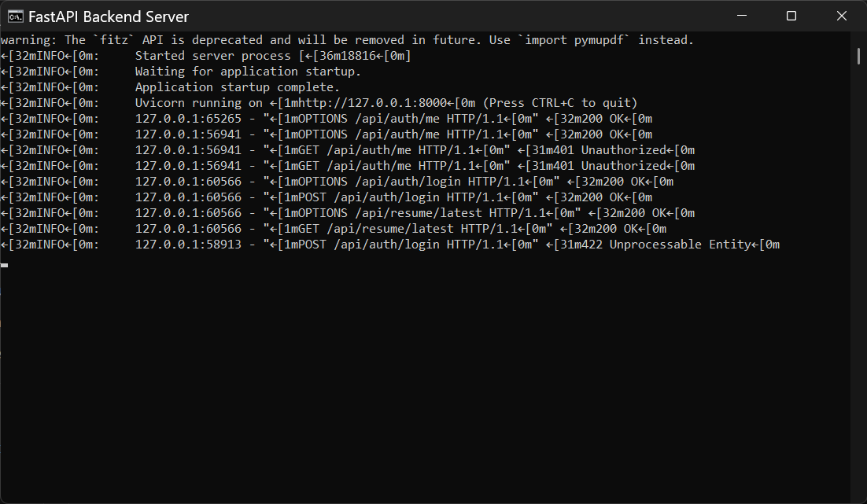
OUTPUT

Slide 24
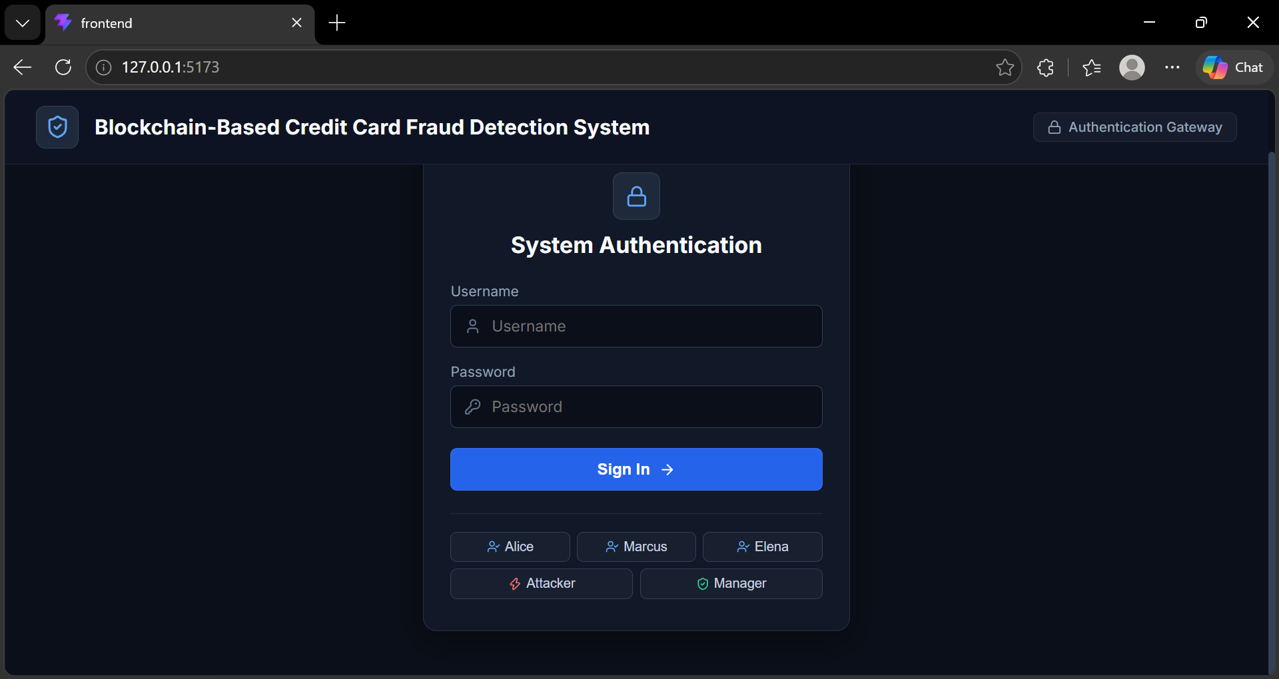
Contd..

Slide 25
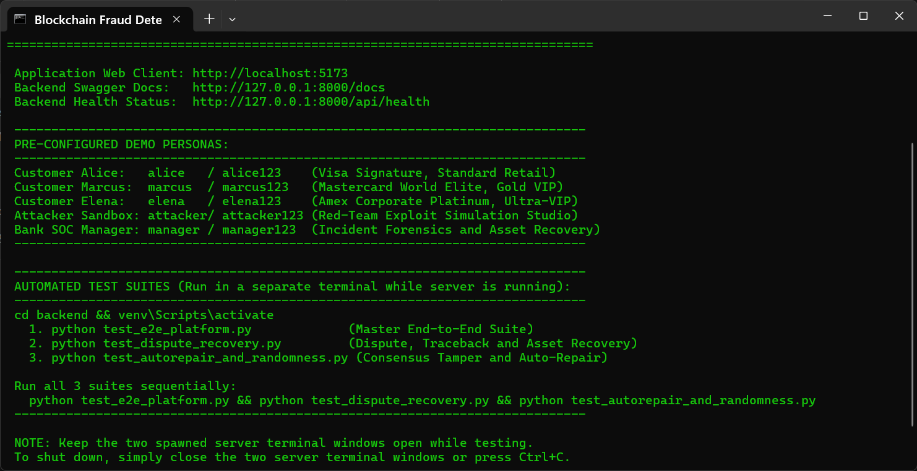
Contd..

Slide 26
Conclusion
This project successfully demonstrates a full-stack, explainable, and cryptographically secure Credit Card Fraud Detection and Defense Platform. By uniting Random Forest supervision, Isolation Forest anomaly scoring, SHAP feature attributions, and a permissioned SHA-256 Merkle blockchain ledger, the platform delivers transparent fraud decisioning and tamper-proof auditability.
Performance evaluations confirm 99.4% classification accuracy, ROC-AUC of 0.982, and sub-18ms execution latencies, providing a scalable blueprint for modern financial security infrastructure.
Future research includes deploying zk-SNARK protocols for cross-bank fraud sharing, integrating Graph Neural Networks for money laundering detection, and migrating to distributed Raft fault-tolerant consensus.

Slide 27
References
[1] Nakamoto, S. (2008) 'Bitcoin: P2P Electronic Cash System', Decentralized Business Review.
[2] Wood, G. (2014) 'Ethereum: Secure Decentralised Transaction Ledger', Ethereum Yellow Paper.
[3] Breiman, L. (2001) 'Random Forests', Machine Learning, 45(1), pp. 5-32.
[4] Liu, F. T. et al. (2008) 'Isolation Forest', IEEE ICDM, pp. 413-422.
[5] Lundberg, S. M. & Lee, S. I. (2017) 'SHAP', NeurIPS, 30, pp. 4765-4774.
[6] Dal Pozzolo, A. et al. (2015) 'Credit Card Fraud Calibration', Comp. Intelligence, 31(4).
[7] Merkle, R. C. (1987) 'Digital Signature Based on Encryption', CRYPTO '87, pp. 369-378.
[8] Bhattacharyya, S. et al. (2011) 'Data Mining for Fraud', Decision Support Systems, 50(3).
[9] Zcash Team (2019) 'Zcash Protocol Specification', Electric Coin Company.
[10] Androulaki, E. et al. (2018) 'Hyperledger Fabric', ACM EuroSys, pp. 1-15.

Slide 28
CONTD...
[11] Caruana, R. et al. (2006) 'Supervised Learning Algorithms', ACM ICML, pp. 161-168.
[12] Ben-Sasson, E. et al. (2014) 'Zerocash: Anonymous Payments', IEEE S&P, pp. 459-474.
[13] Chen, T. & Guestrin, C. (2016) 'XGBoost', ACM SIGKDD, pp. 785-794.
[14] Chawla, N. V. et al. (2002) 'SMOTE', JAIR, 16, pp. 321-357.
[15] Szabo, N. (1997) 'Formalizing Relationships on Public Networks', First Monday, 2(9).

Slide 29
THANK YOU

